Slide 1
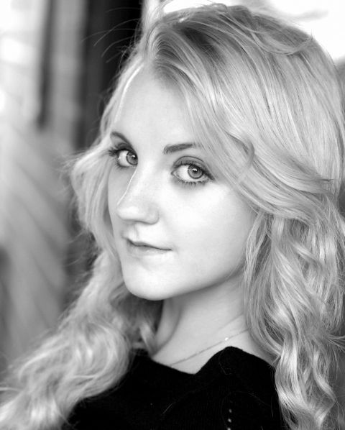
Good luck
Answers!

Slide 2
In the wizarding world the _________ is considered to be the omen of death.

Slide 3
The Grim.

Slide 4
We Love Hermoine
What is Hermoine’s middle name?

Slide 5
Hermione Jean Granger.

Slide 6
What did Harry get as a gift for his 11th birthday ?

Slide 7
Hedwig from Hagrid.

Slide 8
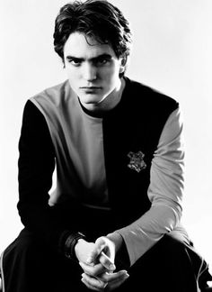
Name the house ghost of the Hufflepuffs

Slide 9
Fat Friar.

Slide 10
Other than Hermoine, Harry and Ron, S.P.E.W contains two other confirmed members.
Name them. (part points will be awarded)

Slide 11
Neville Longbottom.
Dobby.

Slide 12
Macbeth
The _________ are a very popular band in the Wizarding World and on the Wizarding Wireless Network. Albus Dumbledore booked them to perform in Hogwarts at the 1994 Yule Ball. Despite their names, all 8 members are male.

Slide 13
Weird Sisters.

Slide 14
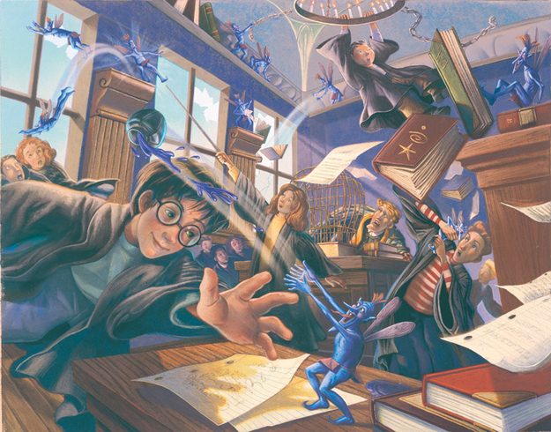
Name these creatures.
7

Slide 15
Cornish Pixies.

Slide 16
Where would you be if you were looking at this?
Enter, stranger, but take heed Of what awaits the sin of greed For those who take, but do not earn Must pay most dearly in their turn So if you seek beneath our floors A treasure that was never yours Thief, you have been warned, beware Of finding more than treasure there

Slide 17
The Gringotts Wizarding Bank.

Slide 18
Who is the professor of astronomy at Hogwarts?

Slide 19
Professor Sinistra.

Slide 20
“….that I have somehow hoodwinked him? Fooled the Dark Lord, the greatest wizard, the most accomplished Legilimens the world has ever seen?”- Severus Snape(Half blood prince)
However fans have speculated for years that X is actually the most powerful legilimens. Who is X?

Slide 21
The Sorting Hat.

Slide 22
Identify the test
The _._._._._._ was a series of tests presented on J.K. Rowling's Official Site, prior to its 2012 redesign. Presented partially as a Harry Potter trivia test, there is nevertheless additional information that can be gleaned from the questions.
Amusingly, Neil Murray, the husband of J. K. Rowling, took the first _._._._._._ and only achieved a score of Acceptable, despite being in the same room as his wife when she was composing the quiz and listening to her read the answers out loud. This discouraged him from attempting either of the following two tests.
(Pic in next slide)

Slide 23

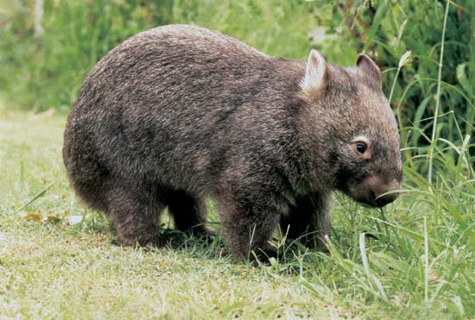
W.O.M.B.A.T.

Slide 24
Who is the Founder and anchor of PotterWatch?

Slide 25
Lee Jordan.

Slide 26
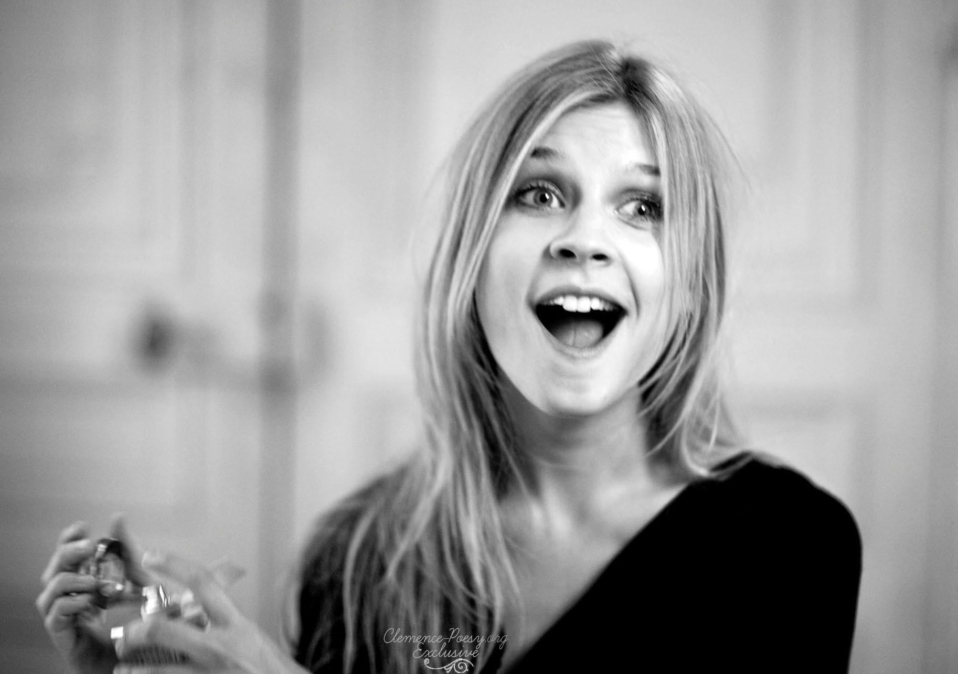
What nickname do the kids( especially Ginny) use to refer to Fleur Delacour ?

Slide 27
Phlegm.

Slide 28
Identify the spell used

Slide 29
Piertotum Locomotor.

Slide 30
Which is the only Harry potter movie to not feature Lord Voldemort?

Slide 31
Harry Potter and The Prisoner of Azkaban.

Slide 32
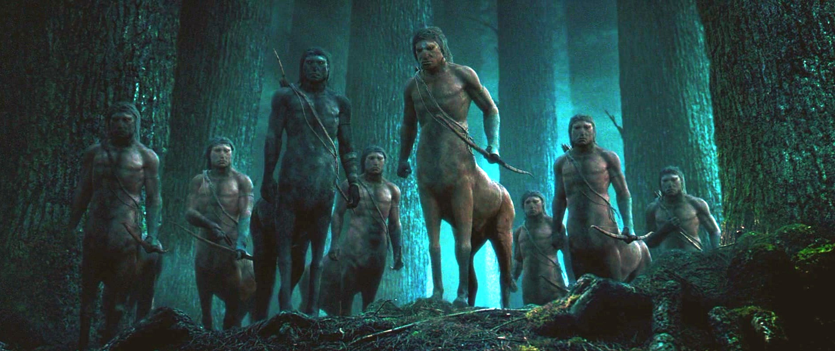
Name any 3 centaurs (no part points) Tie-breaker Bonus for 4 centaurs!
16

Slide 33
Firenze.
Bane.
Ronan.
Magorian.

Slide 34
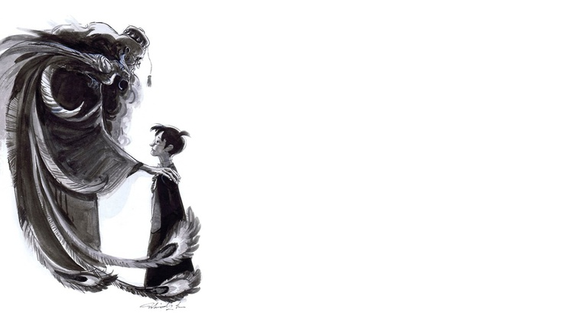
Name any two titles held by Albus Dumbledore. (Other than Headmaster, Hogwarts.) Bonus points if 3 titles are mentioned!
17

Slide 35
Supreme Mugwump.
Chief Warlock of the Wizengamot.
Grand Sorcerer.

Slide 36
Identify this structure
18
Pic in next slide

Slide 37
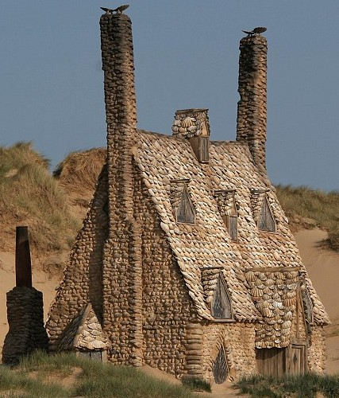

Slide 38
The Shell Cottage.

Slide 39
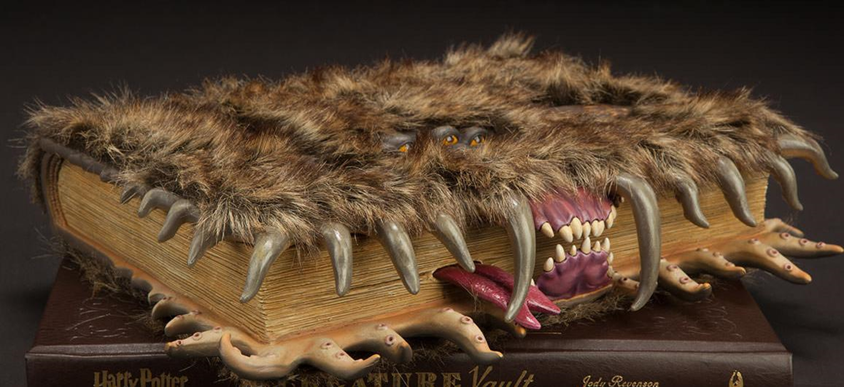
Which book is this?
19

Slide 40
The Monster Book of Monsters.

Slide 41

Identify the composer for this particular theme. (Tie-breaker Bonus for naming the track name!)
20

Slide 42
John Williams
Track name: Hedwig’s Theme.

Slide 43
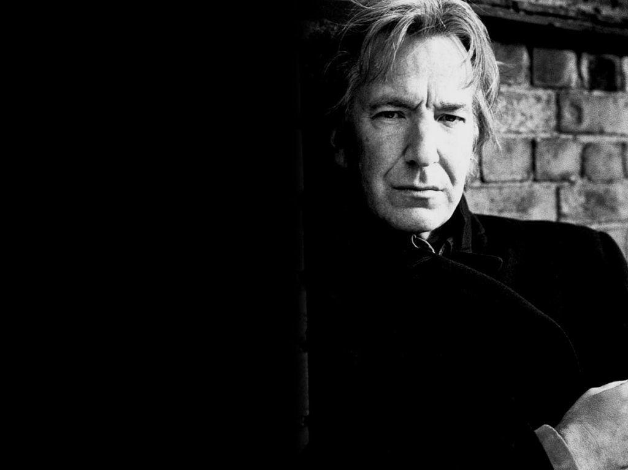
Thank You In the memory of Alan Rickman

